Slide 1
Micro credit Defaulter Prediction
By DEEPAK DABRAL

Slide 2
Problem Description:
The problem at hand here is to predict whether the given individual will be able to return the loaned amount within 5 days of sanctioning or not. The person with ‘0’ label was termed as ‘no’ and the person with ‘1’ was termed as yes.

Slide 3
EDA:
In EDA we found that the data was highly imbalanced
No null values were observed
Outliers were observed
0:1 ratio were very high in every aspect
Data was highly skewed
Two columns were string type
Msisdn had no importance
Pdate had to be converted

Slide 4
Data preprocessing:
Unnamed,msisdn feature were dropped
Pdate was converted into integer format into 3 different features day ,month and year
Dataset was split into 2 different variables ‘x’ and ‘y’
‘x’ as independent and ‘y’ as dependent feature.
‘x’ had too many features and some feature had unreasonable value so they had to be reduced
Also some independent features showed high correlation among each other
So in order to treat them, PCA was applied
Now the features were reduced to mere 16 features
Now it was time to train the model

Slide 5
Model Training
After splitting the dataset now ‘x’ and ’y’ were split into 70% train and 30% test using train_test_split function.
Now RandomizedSearchCV was applied to KNN and RandomForest as part of parameter tuning to get the best result out of the algorithm.
Now parameters were applied and training was performed
Algorithms gave very low precision,recall and f1 score for predicting ‘0’.
So SMOTE and ADASYN function were used to cure that and then again algorithms were applied
Now algorithms gave good scores

Slide 6
Report:
The Decision tree classifier had the best results in both SMOTE and ADASYN results with almost 100% result. ‘
Now the model had to be saved with same parameters and Conditions.

Slide 7
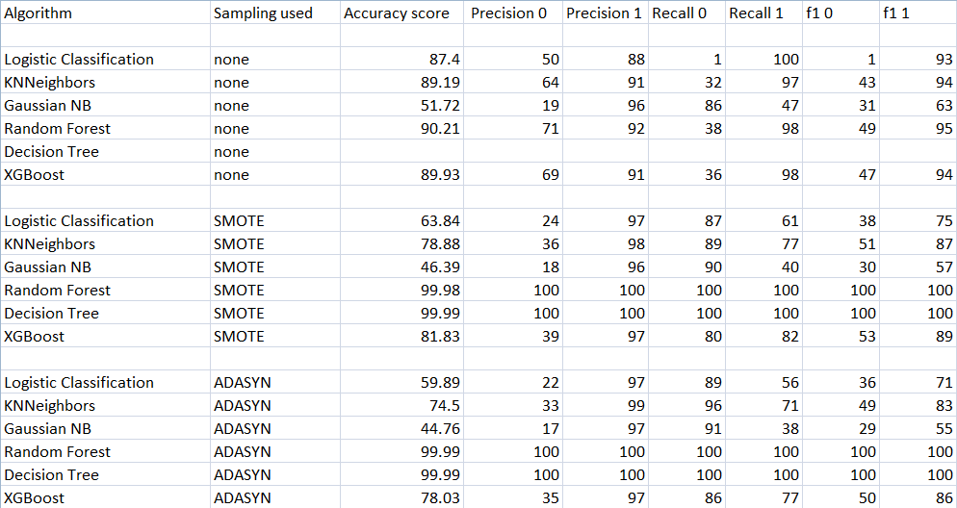
Tabular Form Report

